Slide 1
Requesting api (Question#3)
Syed Measum (201101001)
Sir Sajid

Slide 2
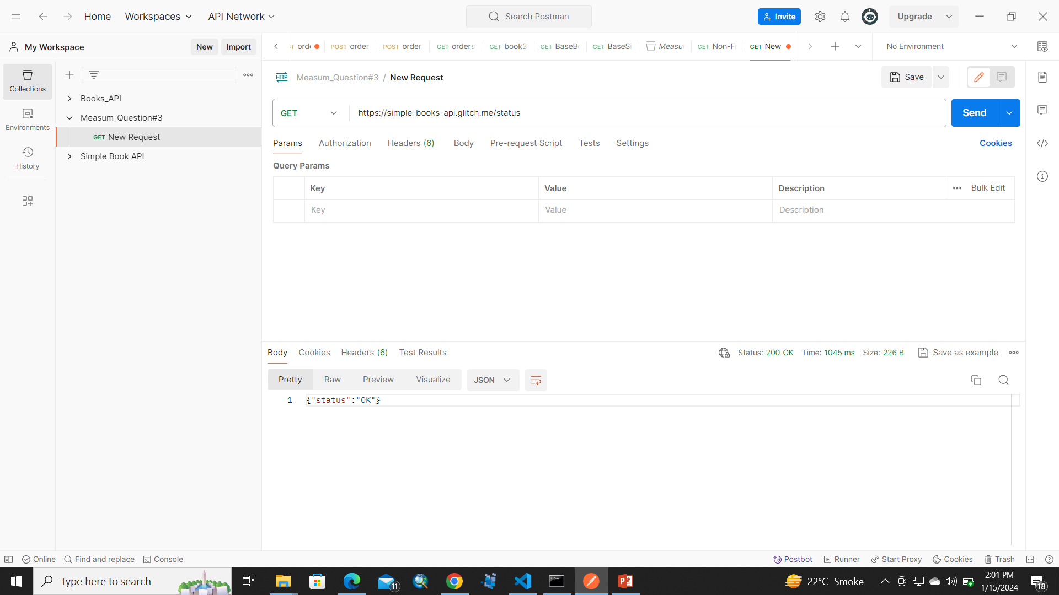
TASK # 1

Slide 3
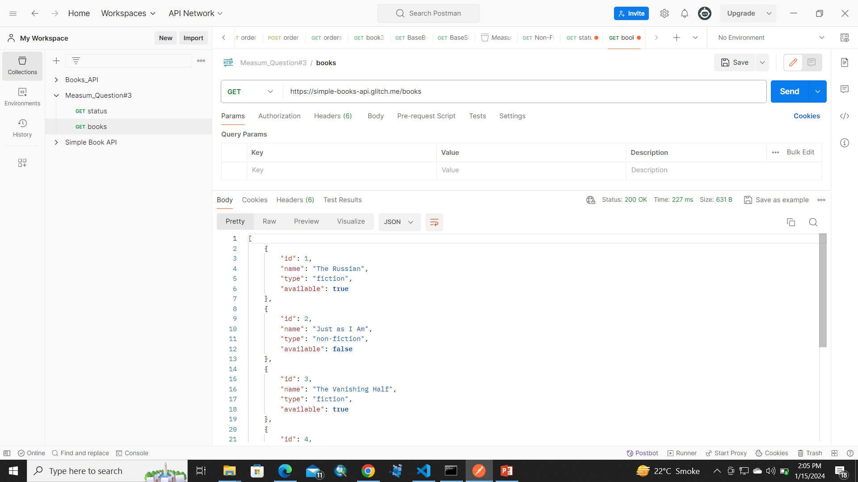
TASK # 2

Slide 4
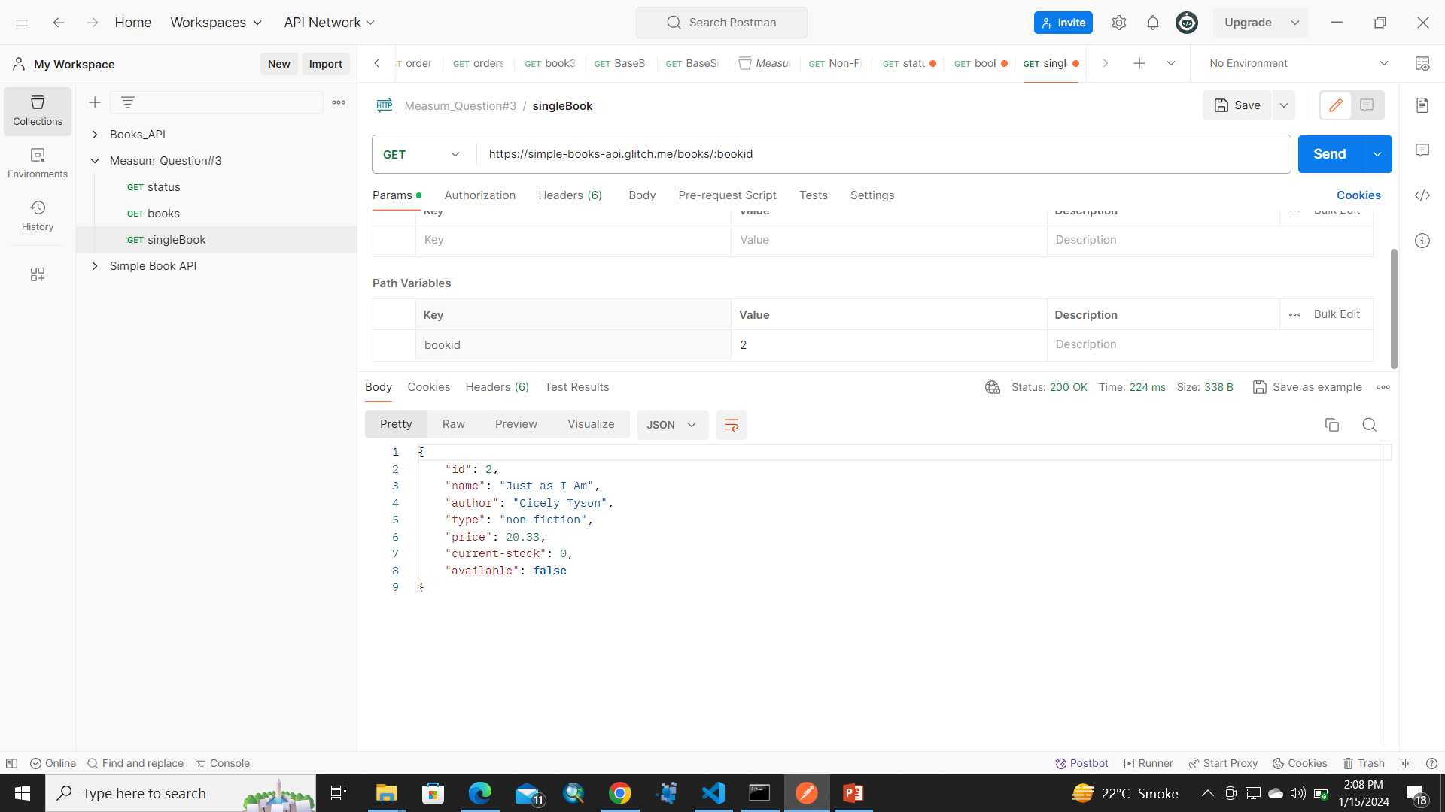
TASK # 3

Slide 5

GENERATING TOKEN

Slide 6
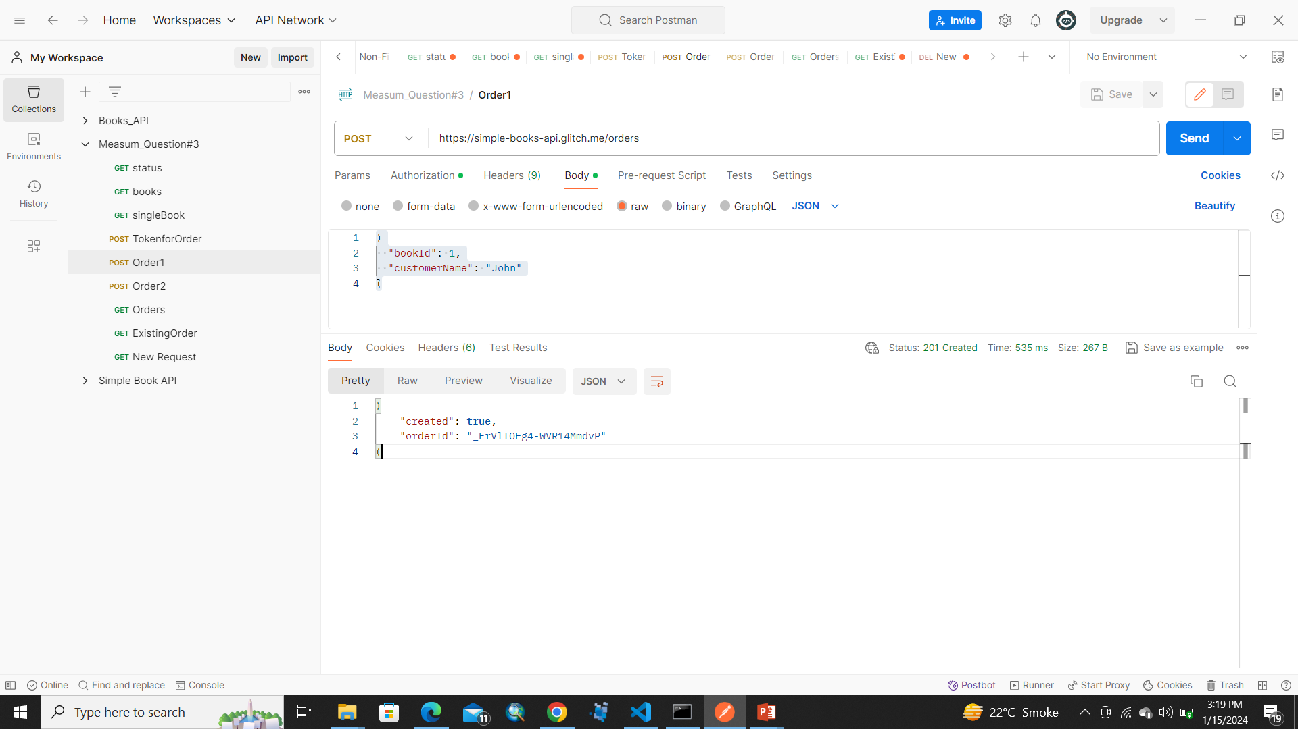
TASK # 4 Order 1

Slide 7

Order 2

Slide 8
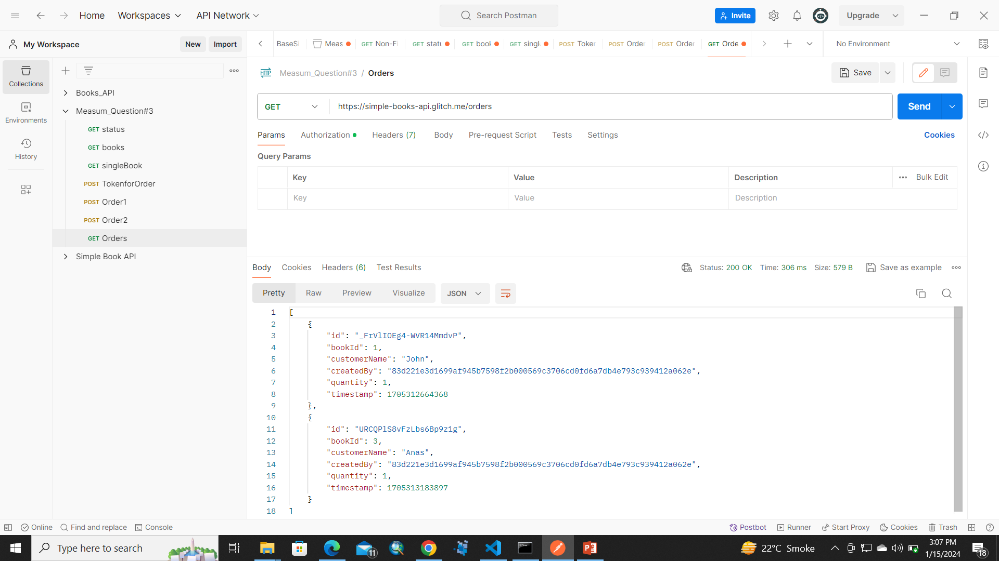
TASK # 5

Slide 9

TASK # 6

Slide 10
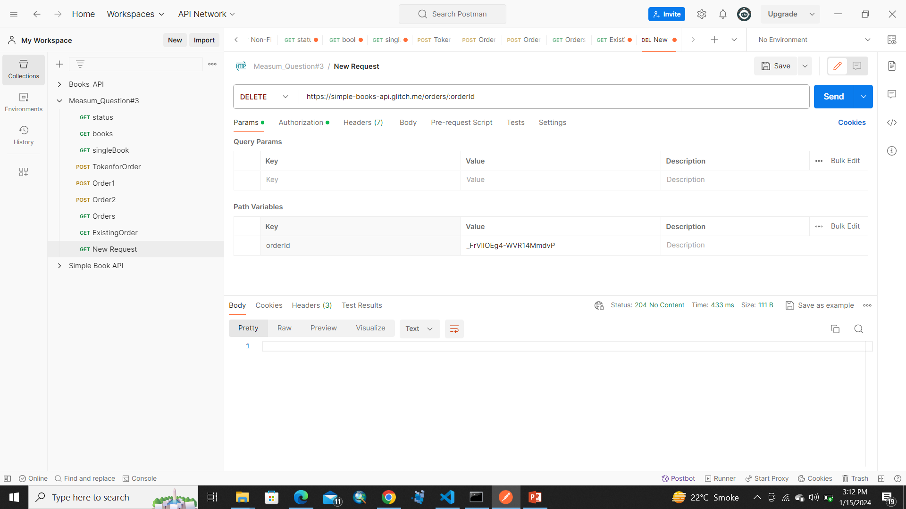
TASK # 7

